Slide 1
Chapter 8
Valuation of shares and debentures (sequence swopped inside ch)
Slides by Prof C Rootman,
Dr S Watson, Ms E Kobese
& Ms N Maliwa

Slide 2
Learning outcomes: Chapter 8
distinguish between different types of value
determine value based on the discounted cash flow (DCF) technique
determine the value of debentures
determine the yield to maturity (YTM)
determine the value of ordinary shares.

Slide 3

Introduction
Valuation is based on 2 fundamental principles of financial management: TVM and risk-return (do you remember Ch 1…?)
Think back to Ch 1. Current value of a house you consider buying? On what does it depend?
TVM features in valuation; Basic valuation model calculates the sum of the PVs of all net cash inflows expected for the duration (life) of the investment
The discount rate used is determined by the risk and return associated with the asset/investment
Magnitude of CF , accelerates CF, riskiness …result in value ☺

Slide 4
Introduction (cont.)
Par value (FV): value asset is issued at in primary market
NB for accounting; st of fin pos shows shareholders’ interest @ par value
Market value (PV): value asset assumes once it trades in market; determined by demand and supply
Market value added: amount firm’s shares in market value over a period
Market capitalisation: # shares issued x MV per sh
Reminder: book value is value of e.g. NC assets in st of fin pos
Remainder of ch and focus of FM: economic value
NB: CFs, timing, discount rate
Disc rate links with risk…

Slide 5
Bonds examples
Source: https://www.thefreelibrary.com/Pepkor+Holdings+Limited+Places+R1.25+Billion+in+South+African+Bond...-a0833193931 (info as per IAR 2025)

Slide 6
Basic valuation model
Put in different ways…make sure you understand this critical point (Do remember our end Ch 1 discussions…?)
Value = sum of PVs or discounted future CFs of expected div and/or in market value
Value = PV of all future CFs expected over relevant period
Value = CFs or returns expected to be generated for owner during the period of ownership
Can you “see” the equation in your mind…?

Slide 7
Basic valuation model (cont.)
Because of TVM and risk: preferable to have CFs earlier than later; therefore, timing along with estimates of CF necessary for valuation
Discount rate should reflect the risk-return
Lower risk; higher value of asset
Higher risk; higher discount rate to use in calculating PV (to account for higher risk/will expect higher return)

Slide 8
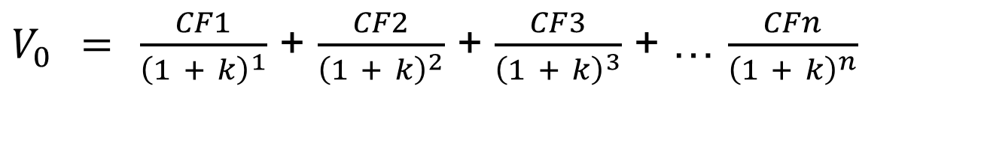

Basic valuation model (cont.)
So, as mentioned…
Discount expected CFs back to PVs using appropriate discount rate
$V_{0} =$ $\frac{CF1}{{\left(1 + k\right)}^{1}}$ + $\frac{CF2}{{\left(1 + k\right)}^{2}}$ + $\frac{CF3}{{\left(1 + k\right)}^{3}}$ + … $\frac{CFn}{{\left(1 + k\right)}^{n}}$
$$P_{0} = \sum_{t = 0}^{t}{\frac{1}{{\left(1 + ks\right)}^{t}}}$$

Slide 9
Basic valuation model (cont.)
An asset is expected to generate CFs of R150, R0, R180 and R300 at the end of years 1, 2, 3 and 4 respectively. The opportunity cost and risk premium of investing in the asset is 14%. What is the value of the asset today (current value)?
Key in | Press | Display
0 | ENT
150 | ENT
0 | ENT
180 | ENT
300 | ENT | 2nd F ENT
14 | ENT | Down arrow COMP
 | NPV | R430.70
All (sum) future CFs
Discounted or PVs

Slide 10
Valuation of debentures
Used by companies as one of their forms of LT debt financing
Part of capital structuring decisions
Enables companies to borrow money from diverse lenders for long periods
Debenture is an interest-only loan: borrower will pay only interest every period and none of the principal amount, until maturity (end) of the loan

Slide 11
Valuation of debentures (cont.)
Maturity is when principal amount should be paid (time to maturity in years)
Interest can be paid semi-annually, i.e. twice a/per year or annum
Yield-to-maturity: rate of return investors earn if they buy a debenture at a specific price and hold it until maturity
Interest payments = coupons = PMT on calculator
Value of a debenture depends on various factors
Remember earlier discussions: CFs matter, timing of CFs matter, risk matters…

Slide 12
Valuation of debentures (cont.)
Value of a debenture depends on various factors
Remember earlier discussions: CFs matter, timing of CFs matter, risk matters…
Required returns: when required return is > coupon rate, there is higher risk; debenture value < its par value and vice versa
Time to maturity: when required return different from coupon rate, the debenture value will approach its par value as it moves closer to maturity; shorter amount of time… the less responsive MV is to change in require return because of lower interest rate risk

Slide 13
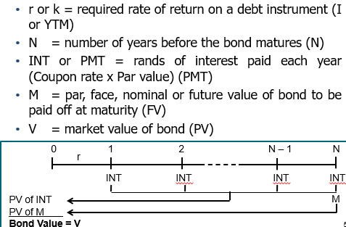
Valuation of debentures (cont.)

Slide 14

Valuation of debentures (cont.)
You can even put it this way for a bond
It still remains the following, for calculating current value
$$P_{0} = \sum_{t = 0}^{t}{\frac{1}{{\left(1 + ks\right)}^{t}}}$$

Slide 15
Valuation of debentures – Textbook pg. 169
Par value or Maturity value or Face value or FV = 1 000
Interest paid semi-annually; rate of return = coupon rate (in THIS example, not always) = 14%; but semi-annually (twice p.a.), so I/Y = 14 / 2 = 7
Coupon or PMT = 14% of 1 000 = 140; paid semi-annually (twice p.a.), so 140 / 2 = 70 per period
Time or N = 10 x 2 = 20
What should you enter as a - ? Why?
Current value or price (PV) of the debenture?
PV = R1 000
FV and PMT…

Slide 16
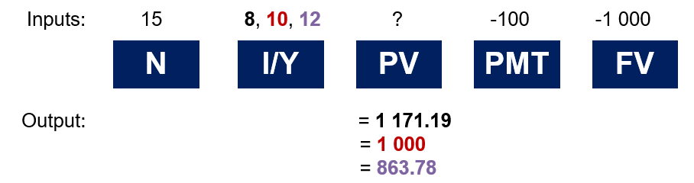
Valuation of debentures (cont.)
CLEAR CALCULATOR MEMORY AFTER EVERY CALCULATION…
Example: 10% coupon bond making annual payments and will mature in 15 years. Calculate the current market price of a bond if the YTM is 8%, 10% and 12%.

Slide 17
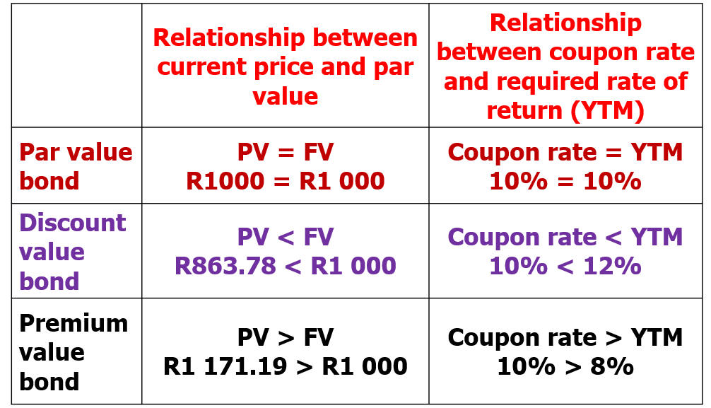
Valuation of debentures (cont.)

Slide 18
Valuation of debentures
Increase in interest rates will cause price of an outstanding bond to fall
MV of bond always approach par value as its maturity date approaches, provided firm does not go bankrupt

Slide 19
Valuation of debentures (cont.)
Par value or Maturity value or Face value or FV = 1 000
Interest paid quarterly = 12%; but quarterly (four times p.a.), so I/Y = 12 / 4 = 3
Coupon or PMT = 15% of 1 000 = 150; paid quarterly (four times p.a.), so 150 / 4 = 37.50 per period
Time or N = 5 x 4 = 20
What should you enter as a - ? Why?
Current value or price (PV) of the debenture?
PV = R…………
Is this a par value, premium or discount bond? How do you know?
FV and PMT…

Slide 20
Valuation of debentures - Examples
Calculate PV of bonds A and B which both have a par value of R1 000:
A: 12% coupon; YTM = 10%; 5 years to maturity
B: 12% coupon; YTM = 10%; 30 years to maturity
A: FV = -1 000; PMT = -120; I = 10; N = 5;
comp PV = R………….
B: FV = -1 000; PMT = -120; I = 10; N = 30
comp PV = R1 188.54
What do you notice?
Both bonds are premium bonds (PV > par; coupon > YTM)

Slide 21
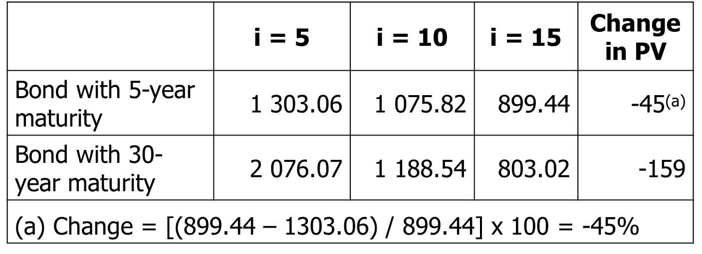
Valuation of debentures – Egs (cont.)
Now assume that interest rates (required rates) increase to 15% and then decrease to 5%. What will the effect of changing interest rates be on the PVs of the two bonds? Comparison:
Value of both bonds as discount (interest) rate
Bond with 30-year maturity more sensitive to changes in discount (interest) rate

Slide 22
Valuation of debentures – Egs (cont.)
Now consider the following bonds with the same maturity but different coupon rates:
C: 30 years to maturity; YTM = 10%; 6% coupon
D: 30 years to maturity; YTM = 10%; 3% coupon
C: FV = -1 000; N = 30; I = 10; PMT = -60
comp PV = R622.92
D: FV = -1 000; N = 30; I = 10; PMT = -30
comp PV = R340.12
What do you notice?
Both bonds are discount bonds (PVs < par)
Why? Coupon rates are < YTM

Slide 23
Valuation of debentures – Egs (cont.)
What will happen to the value of the bonds if interest rates increase to 15% and then drop to 5%?
Here too PVs of both bonds as interest rate and one with lower coupon decreases most (i.e. most sensitive)
 | i = 5 | i = 10 | i = 15 | Change in PV
Bond with 6% coupon | 1 153.72 | 622.92 | 409.06 | -182
Bond with 3% coupon | 692.55 | 340.12 | 212.08 | -227

Slide 24
Valuation of debentures – Textbook pg. 171
FV = -1 000
PV = 840
N = 10
Interest paid annually @ 15%
Calculate YTM
Solution
Coupon/interest pmt or PMT = 15% of 1 000 = -150
I or YTM = 18.64%

Slide 25
Valuation of debentures – Egs (cont.)
Willy Wonca Ltd issued bonds with a coupon rate of 7.5% per annum. The bonds make annual payments and has a face value of R1 000. The current market value of one of these bonds is R1 139.42. The YTM on these bonds is 6%. Calculate these bonds’ time to maturity.
Calculate N
Solution
PMT = -75; FV = -1 000; PV = 1 139.42; I = 6
N = 13.99 or 14 years

Slide 26
Valuation of shares - Examples
Source: https://thespargroup.com/wp-content/uploads/2025/12/SPAR_IAR_2025.pdf
Notes:
5

Slide 27
Valuation of shares - Examples
Source:
https://www.bbrief.co.za/2025/12/09/spar-r5-billion-loss-what-really-happened-in-2025/; https://www.sharedata.co.za/v2/Scripts/Quote.aspx?c=SPP&x=JSE
Notes:
5

Slide 28
Valuation of shares - Examples
Source: https://www.sharenet.co.za/v3/sens_display.php?tdate=20250903070500&seq=1&scode=WHL; www.sharedata.co.za
Notes:
5

Slide 29
Valuation of shares – Egs (cont.)
Source:
https://www.sharedata.co.za/v2/Scripts/Quote.aspx?c=WHL&x=JSE
Notes:
5

Slide 30
Valuation of shares
Firm issues shares, shareholders purchase (buy) shares and thus become owners (shareholders)
Owners of the firm (control it)
Rights and privileges; also expect some form of return in the future… (to be awarded for the risk they incur when investing in the shares)
Investors interested in buying undervalued shares
Dividends (short-term return) income shares
Capital gains/increase in share price or value (long-term return) growth shares
Dividends: entitled to any earnings (profits) that remain… after interest payments (to bondholders) and dividend payments to preference shareholders
Notes:
5

Slide 31
Valuation of shares
Market efficiency relates to flow of information that affects share prices
Investors interested in buying undervalued shares
Strong form: all info is reflected in sh prices
Semi-strong form: all public info is reflected in the sh prices
Weak form: at a minimum, a share’s current price reflects its own past prices
Info influences risk and return of shares…e.g.
An increase in risk will increase required rate of return (k) and may decrease the expected return, forcing sh price to decrease; and vice versa
Notes:
5

Slide 32
Valuation of shares (cont.)
Firm has no obligation to pay ordinary share dividends; Unless directors declare a dividend, it is not a liability; Company can’t become bankrupt because of non-payment of dividends
Dividend payment is not an expense: not tax-deductible; paid out of after-tax profits
Tax paid on dividends received from SA companies and foreign companies listed on JSE
Dividends tax (withholding tax) – company declaring dividend will withhold 20% of total dividend on behalf of shareholders and pay this over to SARS
Government, pension funds do not pay dividend tax
More on dividends in Ch.18
Notes:
5

Slide 33
Valuation of shares (cont.)
Benefit when firm performs well, however, payments to bondholders and preference shareholders are “mandatory” fixed financial obligations, therefore this might reduce ordinary shareholders’ equity and potential dividends
Bears most risk
Last in line to receive any cash distributions (dividends and/or funds left-over after liquidation resulting from bankruptcy)
Par/nominal/face value does not determine market value
No maturity; firm could repurchase…when?
Notes:
5

Slide 34
Valuation of shares (cont.)
Owners of the firm: have voting rights
Elect directors, appoint managers, vote on proposals & mergers, etc.
1 share = 1 vote; thus, more shares = more votes
Vote at AGM in person or sign proxy for other party to vote on your behalf
Pre-emptive right
Offer existing shareholders shares of a new issue before offer to the public
2 reasons why…
Notes:
5

Slide 35
Valuation of shares (cont.)
Preference shares…
similar to bonds with fixed dividend amounts
similar to ordinary shares as dividends are not required and have no fixed maturity date
For the firm safer to use than debt: cannot be forced into bankruptcy if it misses preference dividend payments
Preference dividends fixed; Preference dividend stated as % of par value
Priority over ord. shareholders, but not debt holders
Could be cumulative or convertible
No voting rights; however, …except when dividends are in arrear
Firms have an incentive to delay paying preference dividends…however, at the expense of “corporate control”
Notes:
5

Slide 36

Valuation of ordinary shares
It’s more difficult to determine the current value (or price) of a share than that of a bond…why?
This becomes clear when we consider the equation for P₀ again…
PV is thus the sum of all future CFs discounted at an appropriate discount rate
PV = discounted value
Do remember our discussion and explanation of this equation in Ch 1’s lecture (and earlier)…?! Make sure you UNDERSTAND it
$$P_{0} = \sum_{t = 0}^{t}{\frac{1}{{\left(1 + ks\right)}^{t}}}$$
Notes:
5

Slide 37
Valuation of ordinary shares (cont.)
Unlike bonds, the promised CFs (i.e. future dividends) are not known in advanced ☹
The life of the investment is forever (shares have no maturity)
And we cannot easily observe the rate of return that the market requires (remember Ch 6)
We will now investigate the cases where we can determine the present value (PV) of the future CFs for a share…
Future CFs could be… dividends and capital gains
Notes:
5

Slide 38
Valuation of ordinary shares – Example with 1 period
Suppose you are thinking of purchasing shares from Ncube Oil and you expect it to pay a 300c dividend in one year and you believe that you can sell the share for 2 400c at that time. If you require a return of 20% on investments with an equivalent risk level, what is the maximum price you would be willing to pay for the share now?
Compute the PV of the expected future cash flows
Price = (P₁ + D₁) / (1 + k) same as the Eq.!
= (24 + 3) / (1 + 0.2)
= R22.50
OR FV = 27; I = 20; N = 1; PV = ? PV = R22.50
Notes:
5

Slide 39
Valuation of ordinary shares (cont.)
Easy with one year period…
You would find that the price of the shares is really just the present value (PV) or the discounted value of all expected future dividends
So, how can we estimate all future dividends…?
Want to try any guesses about Massmart…?
Current economic environment…
Dividend policy (Ch 18)…
Notes:
5

Slide 40
Valuation of ordinary shares (cont.)
What is happening to shares of companies that are not currently paying any dividends?
Small growing SMMEs frequently plough back everything they make (retained earnings), thus paying no dividends. Are such shares worth nothing?
Remember the value of the share = PV of the future dividends; we do not rule out the possibility that some of those dividends are zero … they just can’t ALL be zero!
Imagine a company’s articles of association prohibited the paying of dividends now or ever … the shares are worth absolutely NOTHING! Money goes in, but nothing valuable ever comes out. Since nobody would ever get any return on this investment, the investment has no value
So, when we speak about firms that don’t pay dividends, we mean that they are not CURRENTLY paying dividends
Notes:
5

Slide 41
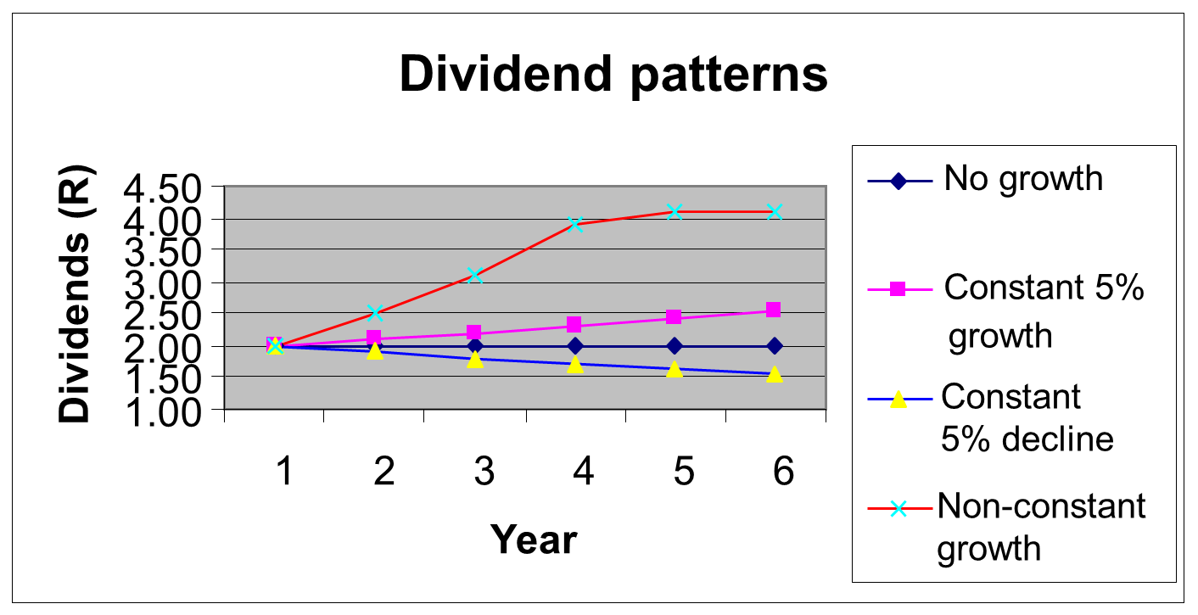
Valuation of ordinary shares (cont.)
Since dividends play a critical role in determining the value of a share, we need to consider various dividend patterns:
Three cases where one can determine the value of a share, while making assumptions about the pattern of future dividends…
Notes:
5

Slide 42
Valuation of ordinary shares (cont.)
Zero growth (constant dividend)
The firm will pay a constant dividend forever (non-growing dividend stream)
E.g. Preference shares
The price is computed using the perpetuity formula
Constant growth
The firm will increase the dividend by a constant percent every period
Variable or non-constant growth
Dividend growth is not consistent initially, but settles down to constant growth eventually
42

Slide 43


Valuation of ordinary shares – Zero growth
Zero growth (constant dividend)
D₁ = D₂ = D₃ = D_{n} = constant
Simplify the eq. and value it as a perpetuity
P₀ = D₁ / k
Let’s look at Example 8.4 on pg. 173
$$P_{0} = \sum_{t = 0}^{t}{\frac{1}{{\left(1 + ks\right)}^{t}}}$$
$$P_{0} =D1 X \sum_{t = 1}^{t}{\frac{1}{{\left(1 + ks\right)}^{t}}}$$
43

Slide 44
Valuation of ordinary shares – Constant growth
Constant growth (dividend growth model)
The firm will increase the dividend with constant % every period
E.g. every year dividend payout will increase with 2% (i.e. it will grow annually with 2%)
Why would companies have such a policy? Things can get tricky if market conditions deteriorate…
We will show in Ch 18 that dividend payments send out signals to investors about the financial health of a firm
A dividend cut is generally seen as BAD NEWS
44

Slide 45

Valuation of ordinary shares – Constant growth (cont.)
$$P_{0} = \sum_{t = 0}^{t}{\frac{1}{{\left(1 + ks\right)}^{t}}}$$
Remember:
D₁ = D₀(1 + g)
D₂ = D₁(1 + g)
D₃ = D₂(1 + g) Etc.
∴D_{t} = D₀(1 + g)^{t}
Last/current dividend = D₀
Expected/next dividend = D₁
Simplify the same eq again!
P₀ = D₁ / (k_{s} – g)
How do companies determine g…?
(given for now; remember the growth rate we used in Ch 5 for LT fin planning?)
45

Slide 46
Valuation of ordinary shares – Constant growth (cont.)
Suppose Big D Inc. just paid a dividend of R0.55. It is expected to increase its dividend by 2% per year. If the market requires a return of 15% on assets of this level of risk, how much should the share be selling for (i.e. what is its PV)?
P₀ = D₁ / (k_{s} – g)
= 0.55(1 + 0.02) / (0.15 – 0.02)
= R4.32
[Note: D₁ = D₀(1 + g)]
Shares with a price less than R10 (as in this case) are called penny stocks
46

Slide 47
Valuation of ordinary shares – Constant growth (cont.)…another use
The Stability Company has just paid a dividend of R3.50 per share. The dividend grows at a steady rate of 8% per year. Based on this information, what will the dividend be in five years?
D₅ = D₄(1 + g)
= D₀(1 + g)⁵
= 3.50(1 + 0.08)⁵
= R………
47

Slide 48
Valuation of ordinary shares – Variable growth
Dividend growth inconsistent initially, but settles down to constant growth eventually
E.g. During very good times in the economy or in specific industries e.g. 30% growth rate in first 3 years, then steady 5% growth rate forever…
Industries’ growth currently? Food vs apparel?
Slowing picking up again: Life Insurance and Food Producers
Low or slow growth currently: Health Care Providers
Calculate it with STEPS (applying the same eq.!)
But, “twice”, since there are 2 periods…
[Note: SAME as in textbook, but slides show a simplified step-by-step way; if you understand it, it is GOLD ☺]
48

Slide 49

Valuation of ordinary shares – Variable growth (cont.)
$$P_{0} = \sum_{t = 0}^{t}{\frac{1}{{\left(1 + ks\right)}^{t}}}$$
1st 2 years growth rate: g = 0.25
After 2 years growth rate: g = 0.1
Dividends just paid (D₀) = 5
Required return (k) = 0.2
2 growth periods…so, APPLY STEPS
Non-constant (high) growth of 25%
Constant growth of 10% forever
time
Year 0
Year 1
Year 2
Year 3 and into infinity
Dividend
D
= 5.00
D
= 6.25
D
= 7.81
D
= 8.59
0
1
2
3
PV D1
ß
ß
PV D2
ß
ß
ß
ß
PV P2
P
= 85.90
2
Sum of PVs
49

Slide 50
Valuation of ordinary shares – Variable growth (cont.)
Step 1: Calculate the dividends during the variable (1st) growth period
Year 1: D₁ = D₀(1 + g) = 5 x (1 + 0.25) = 6.25
Year 2: D₂ = D₁(1 + g) = 6.25 x (1 + 0.25) = 7.81
Step 2: Calculate the PV (discounted) of dividends during the variable (1st) growth period
FV = 6.25; N = 1; I = 20; comp PV = R 5.21
FV = 7.81; N = 2; I = 20; comp PV = R 5.42
Total: R10.63
50

Slide 51
Valuation of ordinary shares – Variable growth (cont.)
Step 3: Determine the value of all the constant dividends which will occur after (@ end of) the variable growth period (thus 2nd period now)
D₃ = D₂(1 + g)
= 7.81(1.1)
= 8.59
P₂ = D₃ / (k – g)
= 8.59 / (0.2 – 0.1) REMEMBER g = 0.1 now!
= R85.90
Ended after 2 years, so need P₂
51

Slide 52
Valuation of ordinary shares – Variable growth (cont.)
Step 4: Determine the PV of the constant CFs after (@ end of) the variable growth period (thus 2nd period now)
[i.e. the PV of what you calculated in step 3]
FV = 85.90; N = 2; I = 20; comp PV = R59.65
Step 5: Get the sum of all the PVs [i.e. those calculated in steps 2 and 4]
P₀ = 10.63 + 59.65= R70.28
52

Slide 53
Valuation of ordinary shares – Other uses
Suppose a firm’s shares are selling for R10.50. They just paid a R1 dividend and dividends are expected to grow at 5% p.a. What is the required return (k)?
Use the dividend growth model…just play around with it…
k = (D₁ / P₀) + g
= (1.05 / 10.50) + 0.05
= 15%
[Remember: we show returns as a % as it is then easier to compare different investment opportunities]
There are two parts to this return:
What is the dividend yield…? (D₁ / P₀) 10%
What is the capital gains yield…? g 5%
53

Slide 54
Valuation of ordinary shares – Variable growth (cont.)…another example
Initial g = 0.3 (for 3 years) thereafter g = 0.07 (forever); k = 0.23; D₀ = 1.50; P₀ = ?
2 growth periods…so, APPLY STEPS
54

Slide 55
Valuation of ordinary shares – Variable growth (cont.)…another example
Step 1: Calculate the dividends during the variable (1st) growth period
D₀ = 1.50
D₁ = D₀(1 + g) = 1.50 (1.3) = 1.95
D₂ = D₁(1 + g) = 1.95 (1.3) = 2.54
D₃ = D₂(1 + g) = 2.54 (1.3) = …….
Step 2: Calculate the PV of dividends during the variable (1st) growth period
PV D₁: n = 1; i = 23; FV = -1.95; comp PV = 1.59
PV D₂: n = 2; i = 23; FV = -2.54; comp PV = 1.68
PV D₃: n = 3; i = 23; FV = -3.30; comp PV = 1.77
Sum = 5.04
55

Slide 56
Valuation of ordinary shares – Variable growth (cont.)…another example
Step 3: Determine the value of all the constant dividends which will occur after (@ end of) the variable growth period (thus 2nd period now)
D₄ = D₃(1 + g) = 3.30 x (1.07) (NB: g = 7%)
= 3.53
P₃ = D₄ / (R – g)
= 3.53 / (0.23 – 0.07)
= R22.06
Ended after 3 years, so need P₃
56

Slide 57
Valuation of ordinary shares – Variable growth (cont.)…another example
Step 4: determine the PV of the constant CFs after (@ end of) the variable growth period (thus 2nd period now)
[i.e. the PV of what you calculated in step 3]
PV of P₃: n = 3; i = 23; FV = -22.06;
comp PV = R………
Step 5: Get the sum of all the PVs [i.e. those calculated in steps 2 and 4]
P₀ = 5.04 + 11.85 = R16.89
[Note textbook Example 8.6 mistake on Pg 175, see if you can correct it…]
57

Slide 58
Additional valuation methods and notes
Price-earnings (P/E) ratio
Value per share = EPS x P/E ratio
See example 8.7 on pg. 176 in textbook
Using CAPM for valuation purposes
Capital asset pricing model
Discussed in Ch 6
Net asset value (NAV)
NAV vs sh price to see if trading at a premium
Substantial assets but low profits may trade at a discount to NAV; so, NAV > sh price
What does this indicate…?

Slide 59
Additional valuation methods and notes (cont.)
Net asset value (NAV)
See example 8.9 on pg. 178 in textbook
NAV = (TA – TL) / issued ordinary shares
If undervalued there exists an opportunity for investors to buy shares
Main fin goal = max. SHW
Valuation models shows fin mngt should pay close attention to div (D), growth or return (g) and req. rate of return (k) because it reflects riskiness
Decisions that influence these three variables can cause the value of the firm’s share (P₀) to change…thus influence SHW

Slide 60
Preparation for next session
Work through Chapter 8
Questions in study guide
Problems at the end of the chapter
Read through Chapter 9 and download/print the slides

